Slide 1
Cloud-based Computing
Neal N. Xiong, Ernst Bekkering, Steven Rice
Northeastern State University, USA

Slide 2
Outline
A Basic Idea: cloud, IoT, SDN, …
Rainfall Estimation Systems
Data Fusion in Mobile Wireless Sensor Networks
NSU Computer Science Beowulf Computing Cluster
Notes:
At the end of this course, you should be able to:
Understand the characteristics and operation of WiFi networks (IEEE 802.11 WLANs)
…and MANETs as well as Bluetooth PANs
Deploy WLAN Hotspots
Use basic wireless network monitoring and analysis tools to troubleshoot and assess performance of WLANs
Tools
Tools
Utilize network modeling and simulation tools to plan WLAN networks
Understand possible attacks against WLANs, classify attacks and threats on Bluetooth PANs, and be able to properly secure WLANs(802.1x port-based authentication)

Slide 3
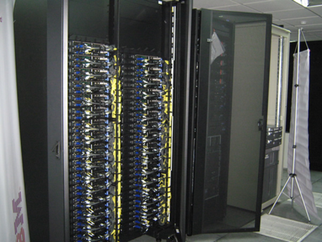
Evolution of HPC, Clusters, Distributed
P2P/Grid/Cloud Computing, and Web Services
Distributed Computing
High Perf. Computing
Similar Proc.
Disparate systems
sharing
Results in High
Performance
Mainly for file sharing
Resource Sharing
P2P
Clusters
Geographically Sparse
Close to each other
No existing framework
Geographically Sparse Within a Framework
Disparate Systems Resource Sharing,
Geographically Sparse Within a Framework
Grid/Cloud
Web
Services
Various
Application
Interaction

Slide 4
Internet of Things – Introduction
The Internet of Things (IoT) is the network of physical objects that contains embedded
technology to communicate
and sense or interact with the objects' internal state or the external environment.*
*Gartner, July 2014

Slide 5
What’s hindering IoT?
What’s hindering IoT?
Fragmentation
Multiplicity of standards
No cross-industrial standard / reference design
Interoperability issues at different levels of software and hardware
Software, Services and Algorithms
Lack of open IP-Based Connectivity Delay in IPv6 deployment
Low Power “Self-healing sensor Network”
Efficient protocol and topology to form Heterogeneous Mesh Networks
Creating flexible and scalable systems
Security & Privacy
Secure and authorized access Privacy of User Data
Models for decentralized authentication Data integrity at consumer devices
IPv
Device & Data Management
Seamless plug-n-play of sensor nodes
Managing millions of connected smart objects & real time event handling
Handling the huge data generated by IoT devices
Collective Intelligence
Individual nodes and sensors may not be “Smart” enough
Need to leverage big data and cluster of sensors/device to bring in collective intelligence
A.De
10

Slide 6
Software-Defined Networking
Separation of Control and Data Plane
Network controlled by SW Applications; suitable for mobile network
Uses general purpose hardware and commodity servers
Enables automated, policy-based control of even massive network
Abstraction of Network Devices
Not reference by individual devices Plug-and-play set up of IoT devices
Automatic remediation of security threats Software-defined things (SDT)
Heterogeneity in IoT Networks
Lack of open IP-Based Connectivity; delay in IPv6 backbone deployment
Efficient protocol and topology to form Heterogeneous Mesh Networks
Objects and protocols have specific design; forcing them to fit with common and singular protocol not good option.
IPv
Edge Computing and Analytics
Individual nodes and sensors potentially could generate tons of data
Provisioning of edge computing/analytics turn data into insights
11
Server Virtualization and Connections
Cloud network; one server acting as multiple servers Architecture for network OS with service/application oriented namespace
Between server: east-west traffic

Slide 7
An Effective Rainfall Estimation System

Slide 8
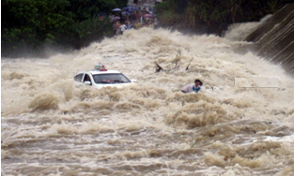
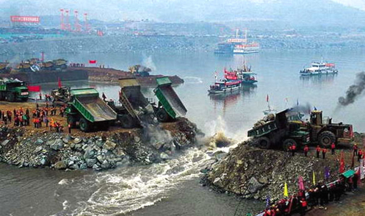
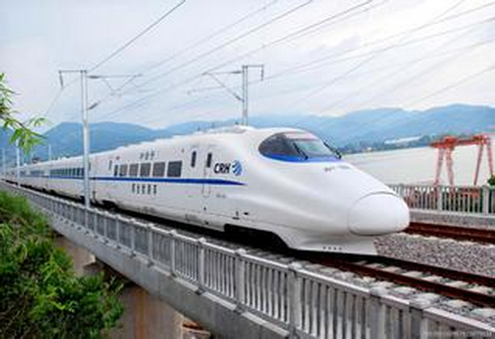
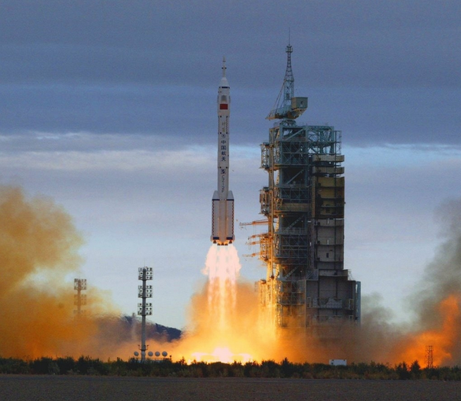
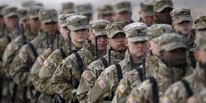
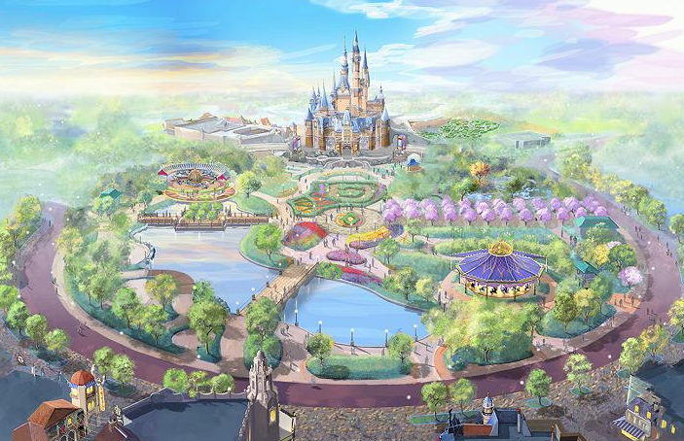
Backgroud
Unfortunately, quantitative precipitation estimation is challenging around the world!
emergency rescue and disaster relief
large scale construction
high speed rail operation support
spacecraft launch
public affair activity
disneyland
accurate precipitation estimation is required

Slide 9
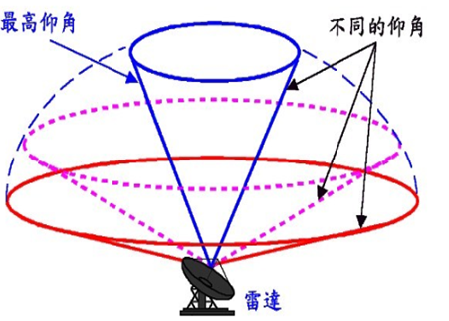
Era of weather radar big data
Volume
larger than 1PB per year.
highest elevation angle
different elevation angles
Velocity
update 6 million observed data for each radar in 6 min.
Variety
radar reflectivity, radial velocity, spectral width, etc.
Value
rainfall estimation, hail recognition, tornado, etc.
weather radar
Veracity
suffer from various factors, high uncertainty.
radar big data
spatial and temporal resolution 1km×1km×6min

Slide 10
Challenges
terrain
season
raindrop distribution
rainfall types
precipitation phase
noise of radar
Affected by
many factors

Slide 11
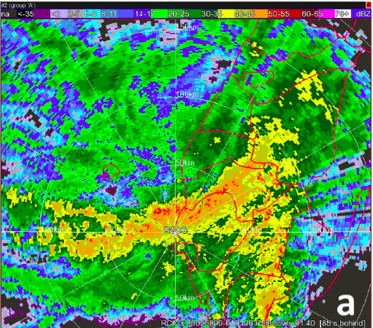
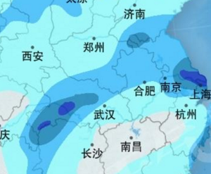
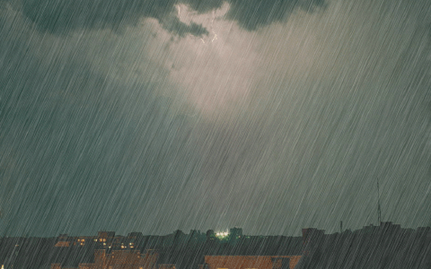
Conventional radar rainfall estimation
estimate
radar data
rainfall data
Difficult to meet
convective
stratiform
ideal condition
Raindrop fall with equivalent speed
low speed of wind
uniform distribution of raindrop

Slide 12
Attempt in machine learning perspective
regression
Xiao et al. TGRS 1997
input 1,2,3,4 km Z,
output R
by NN
Drawback: Existing ML methods directly treat this problem as regression in statistics.
Huang et al. IIDS 2015
input 1,2,3,4 km Z & radial velocity
Kusiak et al. TGRS 2013
by C&RT, SVM, KNN, NN

Slide 13
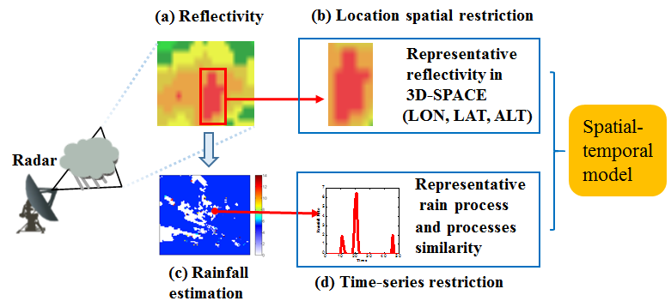
RANLIST model
spatial structure
temporal structure
Qiuming Kuang, Xuebing Yang, Wensheng Zhang, Guoping Zhang. Spatiotemporal Modeling and Implementation for Radar-Based Rainfall Estimation[J]. IEEE Geoscience and Remote Sensing Letters, 13(11):1601-1605, 2016. （SCI，IF: 2.228）
Notes:
loss of Random Forest
rainfall processes with variable time-span
L1 norm regularization term
Space-time Characteristic

Slide 14
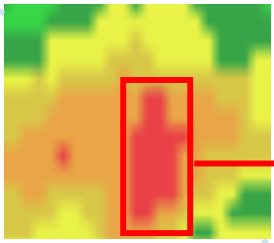
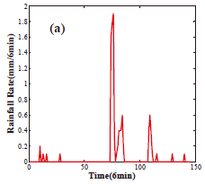
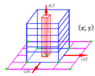
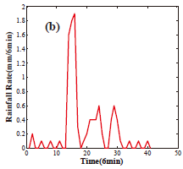
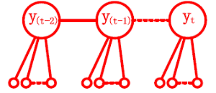
RANLIST model
Spatial submodel RANMP
Time-series rainfall
Reflectivity
X场梯度图像
Time-series submodel LITS
Rain processes
Spatial extention
RF
LCCRF
Y场梯度图像
Spatial
Spatiotemporal model RANLIST
temporal
Notes:
首先，TVRC算法。该式对应着TVRC算法的物理模型，其中。。。为形变场的全局总变分正则化项，考虑了不连续形变；第一个约束项为数据拟合项； 第二个约束项为有参形变场和无参形变参耦合约束项。三项合并，构成如下无约束的拉格朗日目标函数，由平滑和非平滑项组成，求解困难。

Slide 15
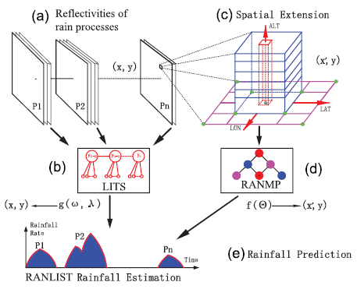
RANLIST——Three-stage optimization
Three-stage
First-stage：
Random Forest method for optimizing
Second-stage：
PSSGB method for optimizing
PSSGB
RF
Three-stage:：
are determined by
validation data set
Notes:
针对该目标函数的求解，我们提出了一种有效的两阶段优化算法。第一阶段，利用经典的有参方法对形变图像进行配准，得到一个全局鲁棒的初始解。将该初始解带入第二阶段，进行的无参优化，得到更加精确的配准图像。对比这两幅图像，可以看出，在第二阶段，高度局部化的形变得到了进一步的改善。右边这一列是残差图像的演化过程，残差图像亮度越大，说明配准越精确。

Slide 16
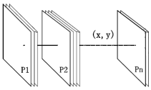
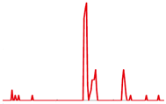
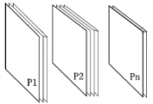
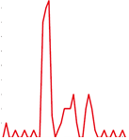
Training RANLIST model
Quality Control
Multiple CAPPI Reflectivity
Spatial Interpolation
Reflectivity factors
Temporal
Interpolation
Data
Matching
Data preprocessing
Time-series rainfall
Obtain rain
processes
Accroding to rainfall
Model training by rain processes
RANLIST
Reflectivity factors for each rain process
Rainfall for each rain process

Slide 17
Workflow of RANLIST model

Slide 18
Data sets for experiments

Slide 19
Experimental areas

Slide 20
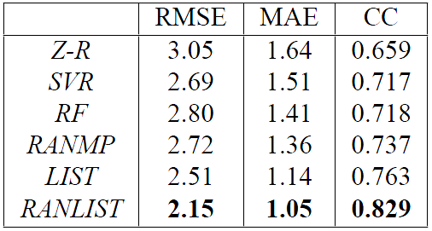
Result
Comparison between radar rainfall estimation and raingauge measurement for Hangzhou radar coverage
mm
mm
Compared to conventional Z-R relationship:
Improvements of 30% in RMSE, 36% in MAE and 26% in CC are obtained
1
2
Compared to random forest:
Improvements of 23% in RMSE, 26% in MAE and 15% in CC are obtained

Slide 21
Evaluation
Several most similar rain process affect rainfall estimation seriously.
Very good fitting rain processes will lead to overfitting.
Number of trees is larger than 50, there is no obvious differences.

Slide 22
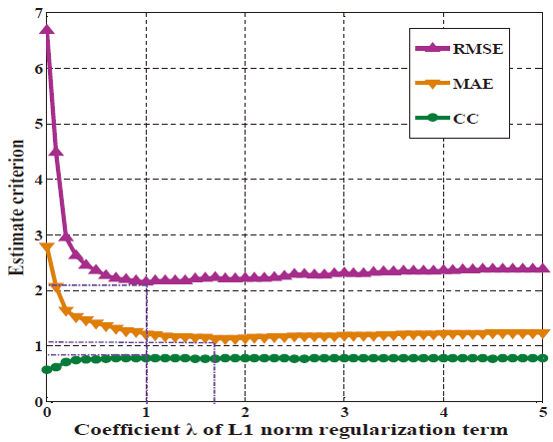
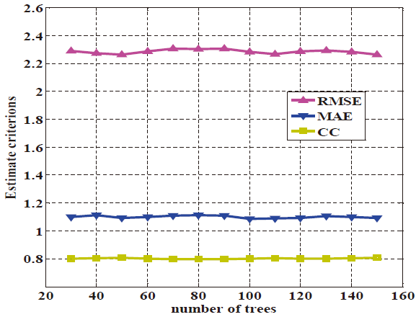
Evaluation
Several most similar rain process affect rainfall estimation seriously.
Very good fitting rain processes will lead to overfitting.
Number of trees is larger than 50, there is no obvious differences.
RANLIST obtain the good performance with between 1 and 1.8

Slide 23
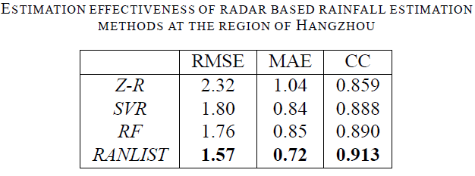
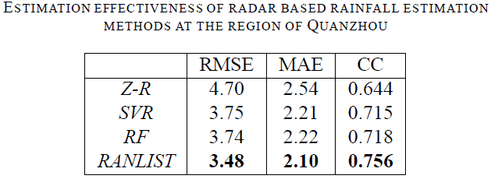
Evaluation
RANLIST model achieves some advantages in both noisy environments.
The performances are affected because a large number of rainfall processes are destroyed by abnormal or missing data.

Slide 24
Evaluation
IDW(Inverse distance weight) and kriging are two typical interpolation methods.
LITS submodel can achieve better performance under interpolating method of kriging.
RANLIST may achieve even good performance using Kriging . However, some more works must be done.

Slide 25
Evaluation
RANLIST obtain good performance when the error of determining no rain is not considered
Rain/no rain classification is especially important for 1-min rainfall estimation

Slide 26
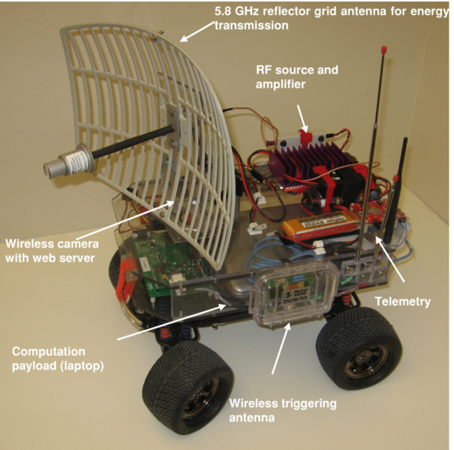
Data Fusion in Mobile Wireless Sensor Networks

Slide 27
Background
Mobile sensors
Work in different environments
Collect data to be fused
Have limited energy and storage
May work with different protocols
When events are detected
Paths are dynamically selected
Data is processed in stages

Slide 28
Application area examples
Monitoring of industrial processes
Oil production
Chemical industry
In presence of danger
Areas with nuclear radiation
Areas with chemical pollution
Many other areas where data has to be collected autonomously

Slide 29
Data fusion architecture

Slide 30
Routing Protocols : query-based

Slide 31
Routing protocols: hierarchical

Slide 32
Routing protocols: chain-based

Slide 33
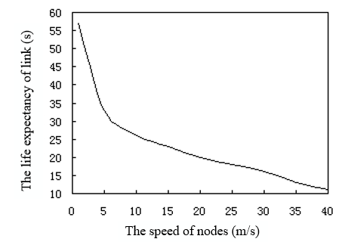
Unique challenges: speed/ energy

Slide 34
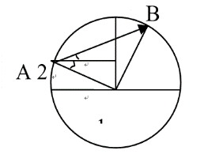
Unique challenges: mobility

Slide 35
Node categories
Sensor node (SN): smart sensors, PDAs, laptops, mobile robots etc. communicate wirelessly.
Cluster head node (CHN) : based on the needs of the application any node may become a cluster head node.
Regional management station (RMS): powerful workstations communicating wirelessly with sensor nodes, and directly connected to the wired network that manages the subnet of the sensor network .

Slide 36
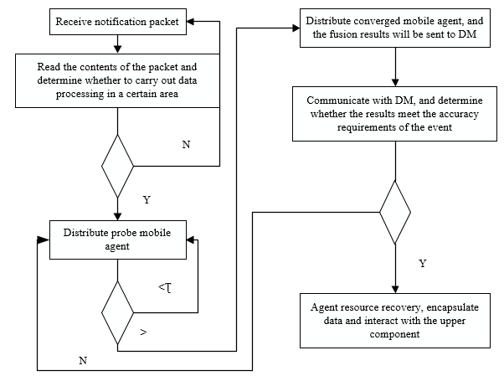
Data fusion/ integration

Slide 37
Where do supercomputers come in?
Kind of hard to just recreate a large mobile network
So: we simulate it on a supercomputer!
In next slides:
C/S = client-server architecture
LCF = local closest first
(GCF = global closest first)

Slide 38
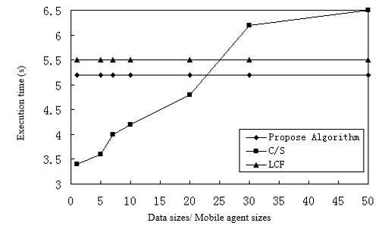
Results: Execution time

Slide 39
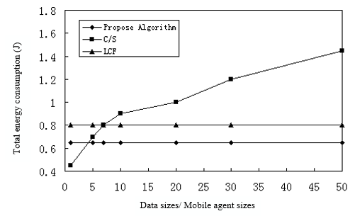
Results: Energy consumption

Slide 40
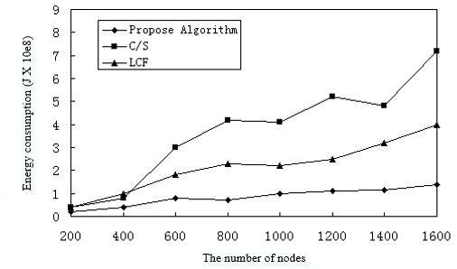
Results: Node density

Slide 41
Conclusions
Lower energy consumption in large number of nodes
Lower transmission time due to data fusion

Slide 42
History of NSU Computer Science Beowulf Computing Cluster
Gordon Shamblin and Steven Rice
Northeastern State University

Slide 43
History of Beowulf Cluster
Donald Becker and Thomas Sterling designed the first Beowulf prototype in 1994 for NASA. It consisted of 16 486-DX4 processors connected by channel-bonded Ethernet. The next Beowulf clusters were built around 16 Pentium Pro (P6) 200-MHz processors connected by Fast Ethernet adapters and switches.

Slide 44
Needs for Cluster
A place to put the cluster.
Computers for the cluster.
Networking for the cluster.
Operating System for the cluster.
Programming Software for the cluster.

Slide 45
A place to put the cluster.
Rack/Table: to hold the equipment
Power Consumption: enough to power the nodes
Ventilation: to keep the area cool
Physical Access: so people can work on the systems
Internet Access: so student can access the cluster

Slide 46
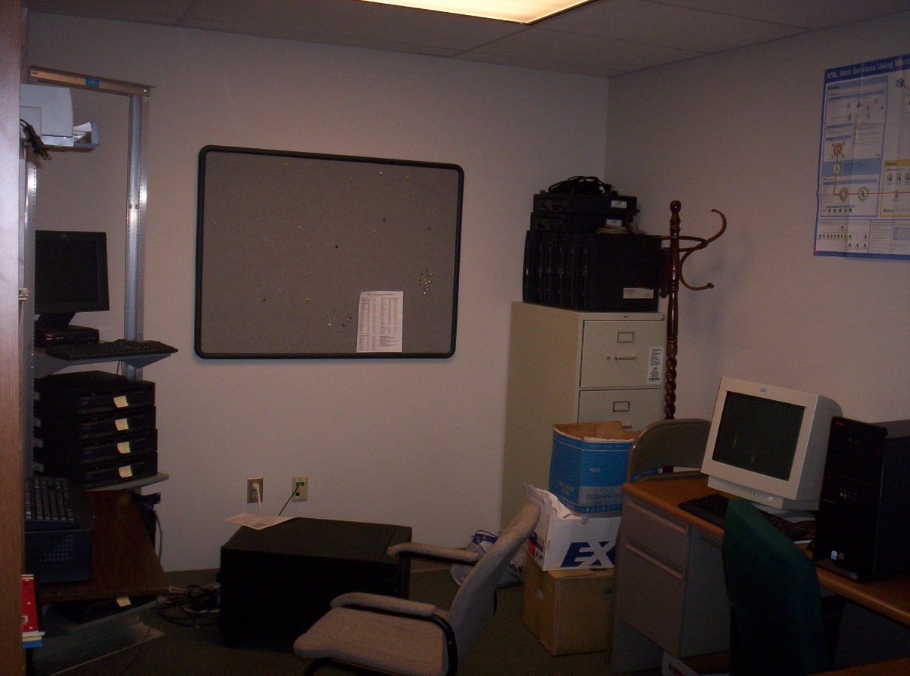
First location for the cluster was to be in a 14’ X 10’ office on a 19” rack.
New location for the cluster is in Science 248, a 30’ X 30’ equipment room with A/C, University conectivity and power

Slide 47
First Cluster.
Master PC
Processor: P4 @ 1.6 GHz
Memory: 768 MB
Drives: 1-40GB, 1-20GB
Networking: 2-10/100Mbps Ethernet adapters
Number of Master = 1
Node PC
Processor: P3 @ 933 MHz
Memory: 384 MB
Drives: 20GB
Networking: 10/100Mbps Ethernet adapter
Number of nodes = 16
Spare PC
Processor: P3 @ 1 GHz & 933 MHz
Memory: 256 MB
Drives: 20GB
Networking: 10/100Mbps Ethernet adapter
Number of units: 3 @ 1GHz, 4 @ 933 MHz

Slide 48
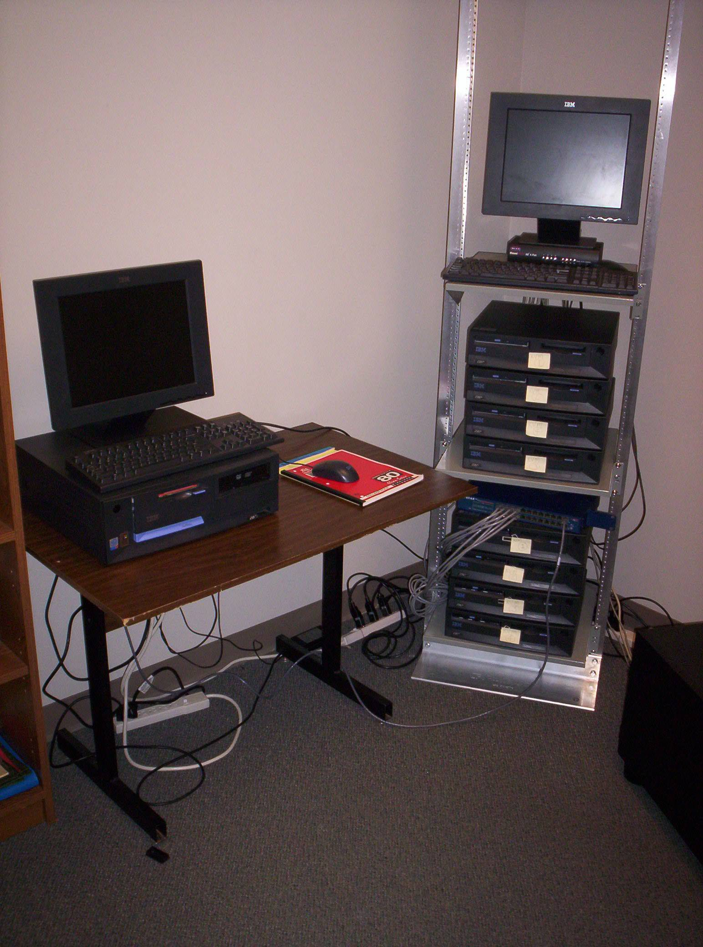
Beowulf
Cluster

Slide 49
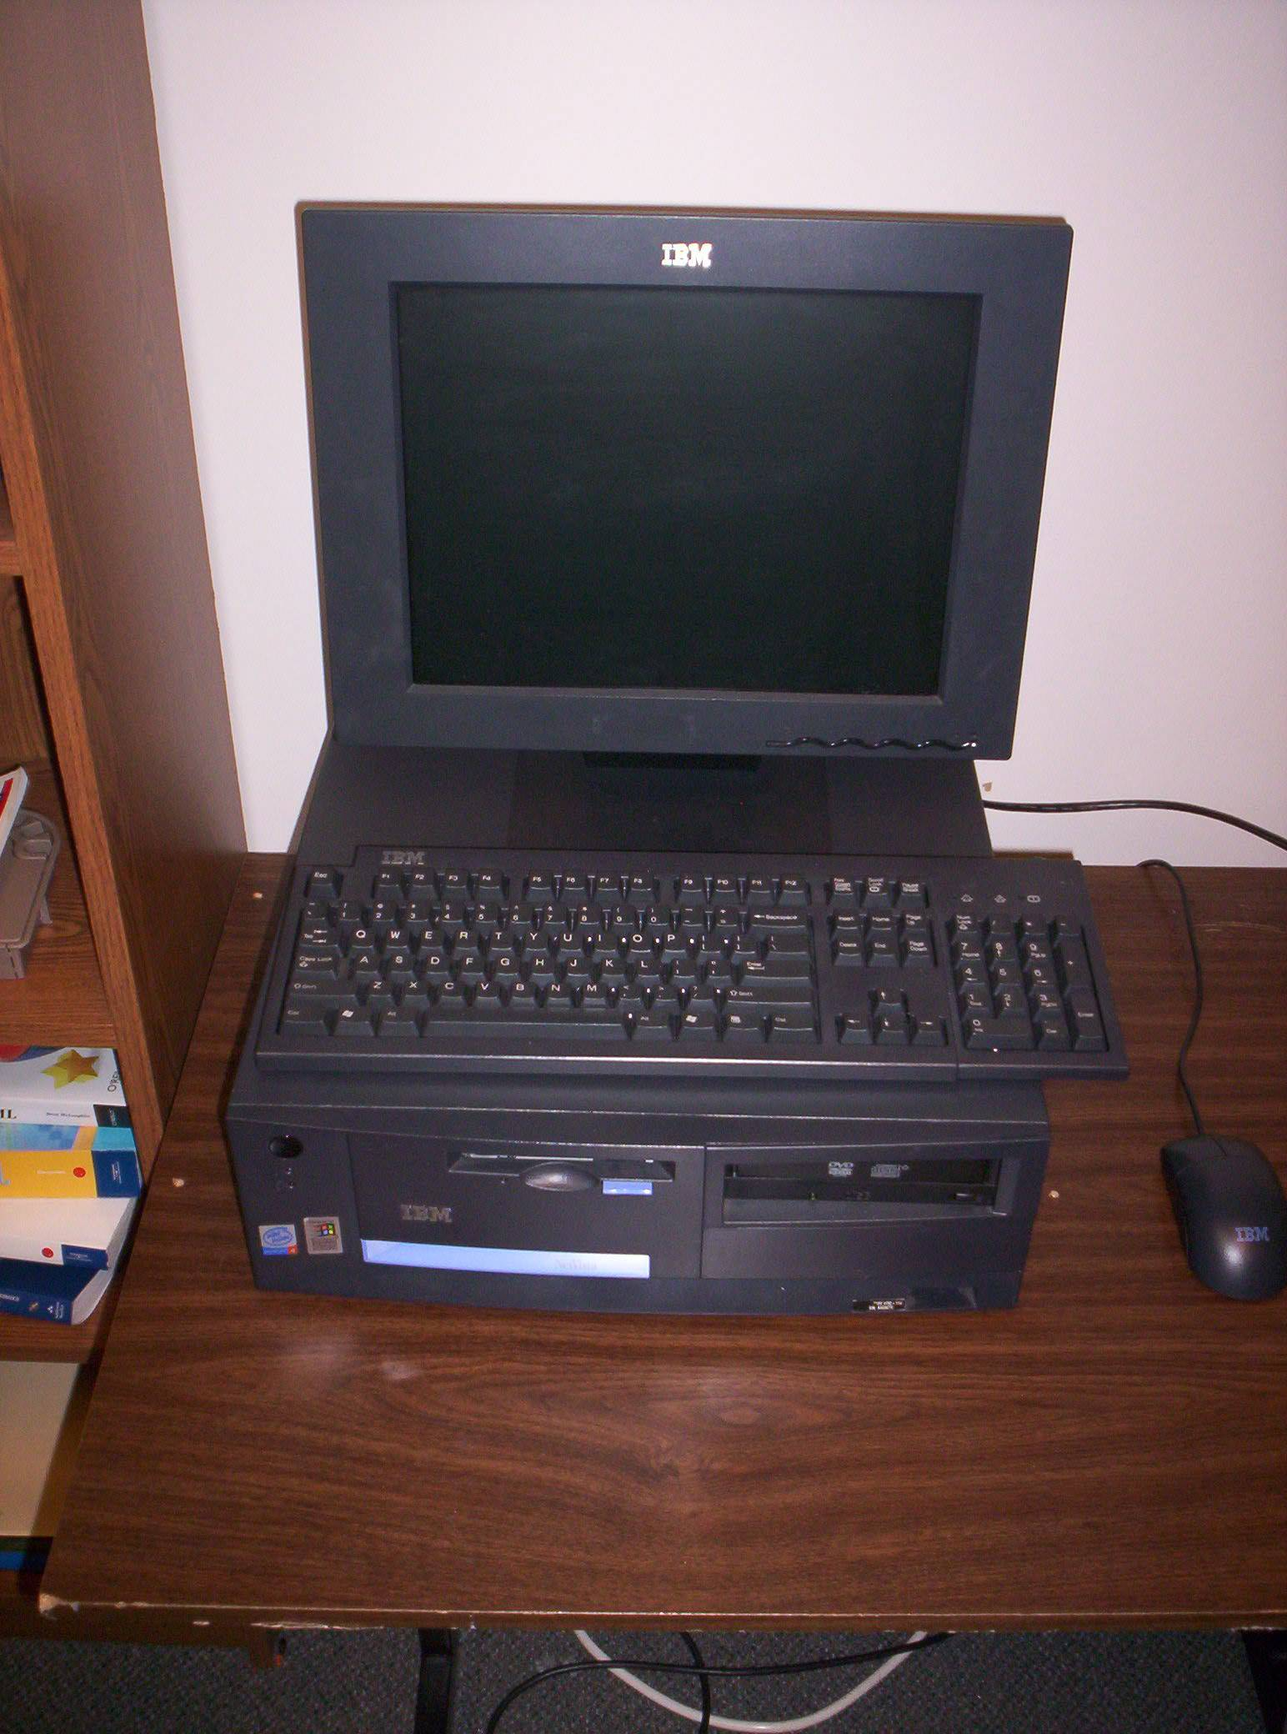
Master
Node

Slide 50
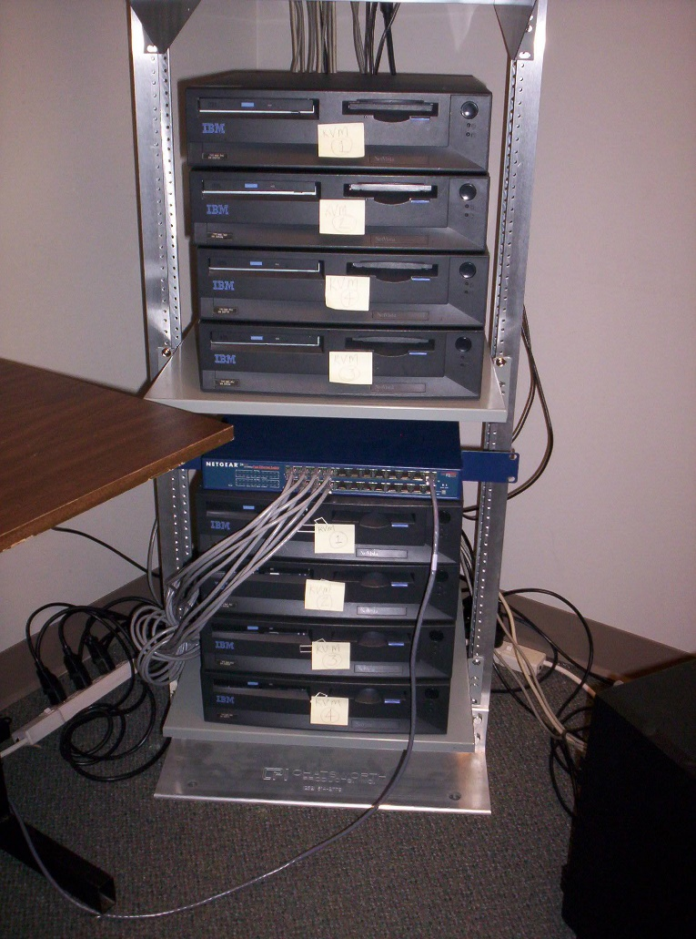
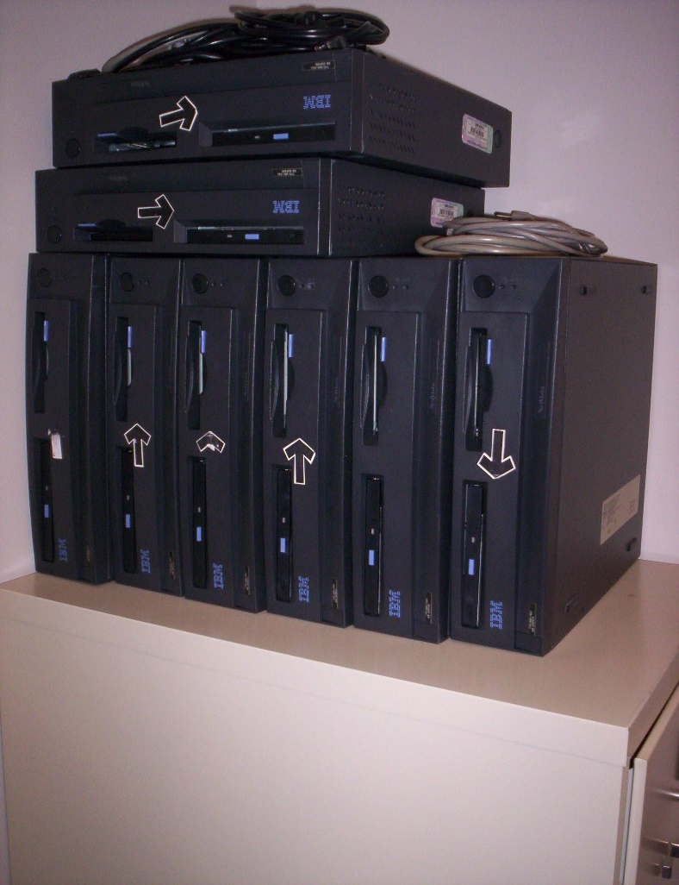
Nodes 9 - 16
Nodes 1 - 8

Slide 51
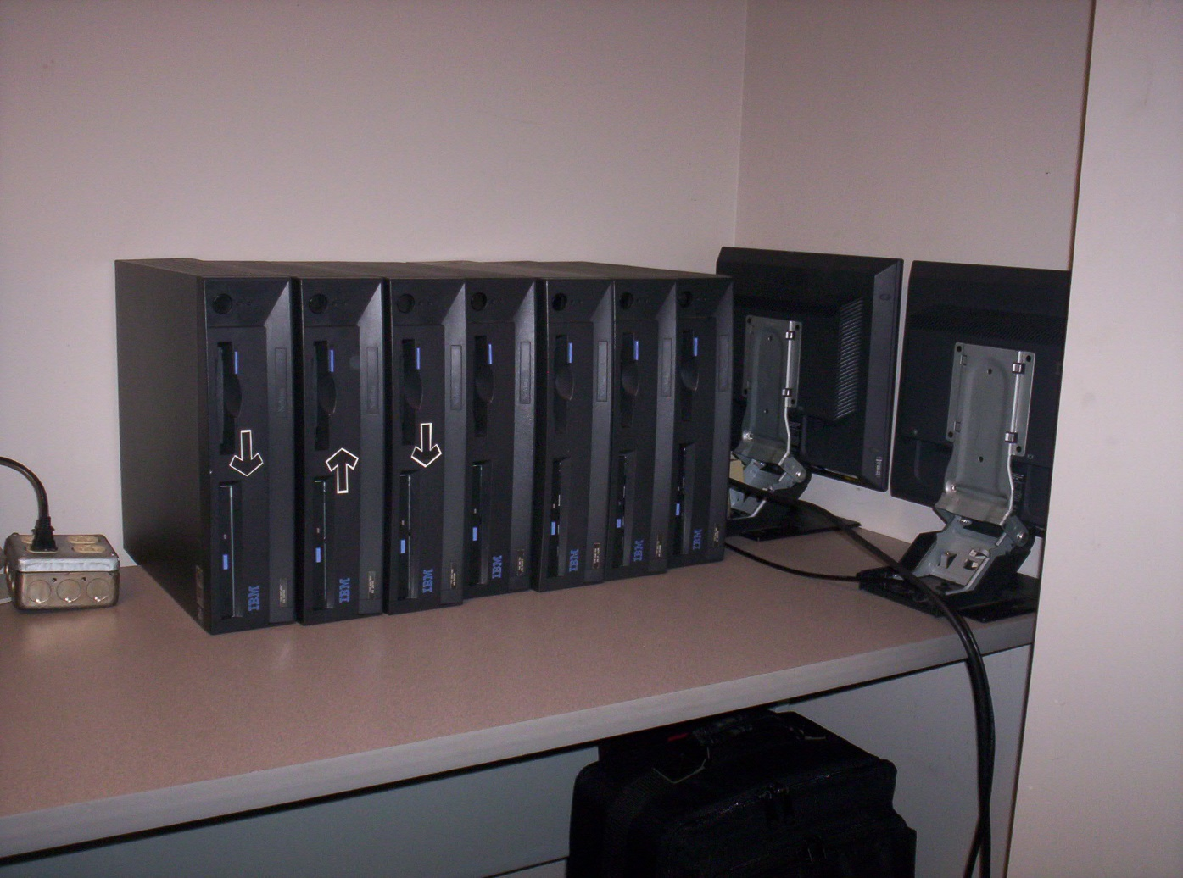
Spares
Nodes

Slide 52
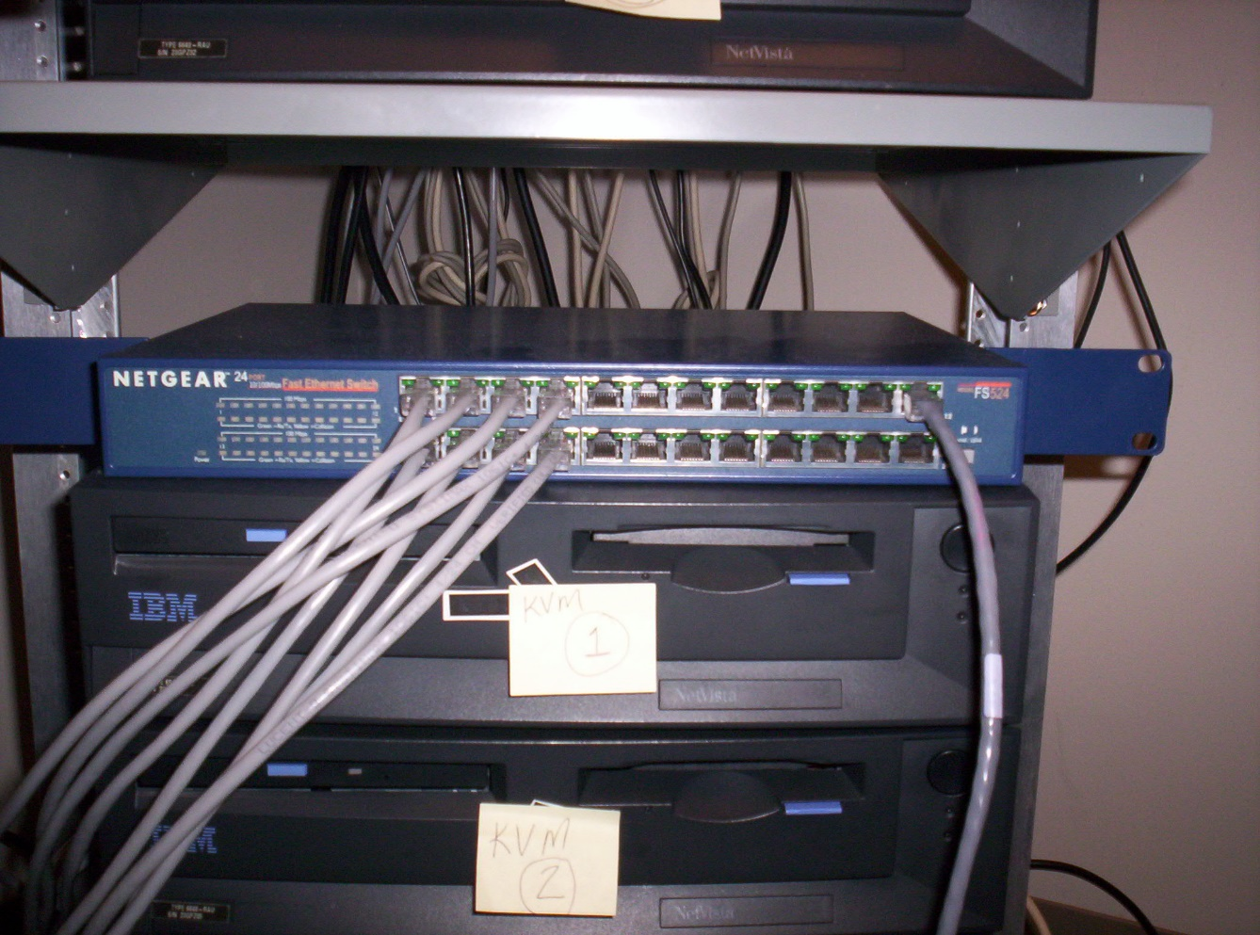
Networking for the cluster.
24 – port Netgear FS524 10/100Mbps Switch

Slide 53
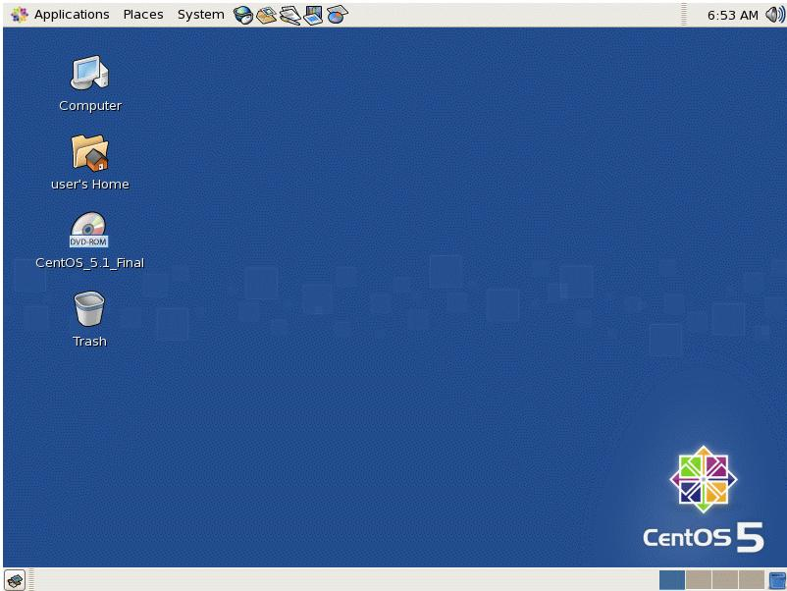
Operating System for the cluster.
CentOS 5.1 Linux based on RedHat Enterprise Linux 5

Slide 54
Second Cluster
This was our main Cluster for more than 6 years. As you can see it was an expansion of our first cluster. It was named: Skynet.
Master PC
Processor: P4 @ 3.0 GHz
Memory: 1 GB
Drives: 1-40GB, 1-20GB
Networking: 2-10/100Mbps Ethernet adapters
Number of Master = 1
Node PC
Processor: P3 @ 933 MHz
Memory: 256 MB
Networking: 10/100Mbps Ethernet adapter
Number of nodes = 64
Spare PC
Processor: P3 @ 1 GHz & 933 MHz
Memory: 256 MB
Networking: 10/100Mbps Ethernet adapter
Number of units: 6 @ 933 MHz

Slide 55
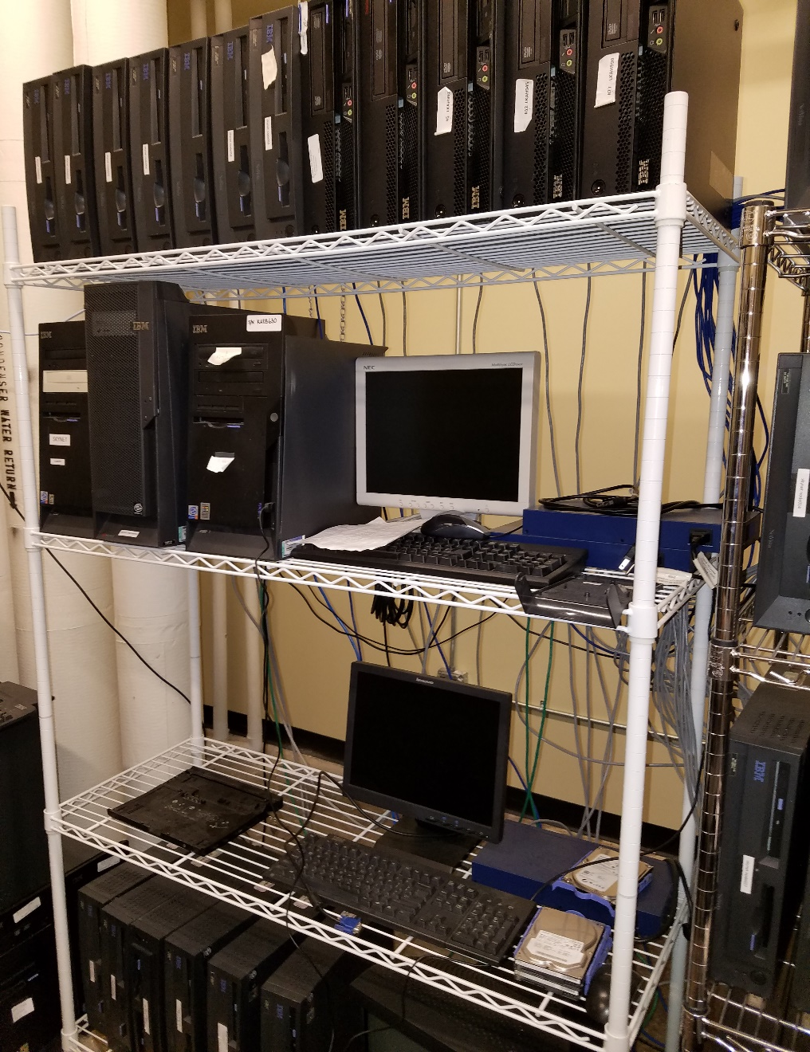

Slide 56
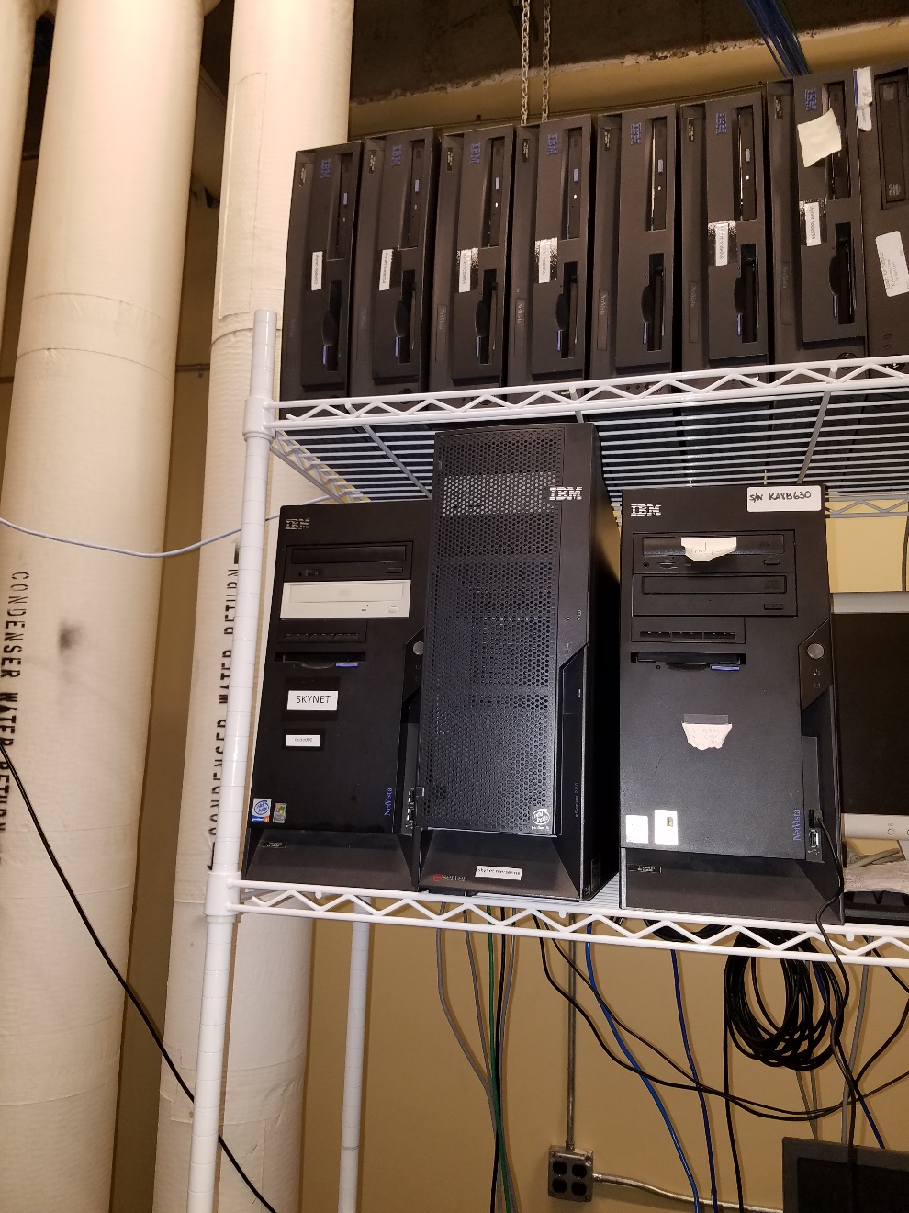
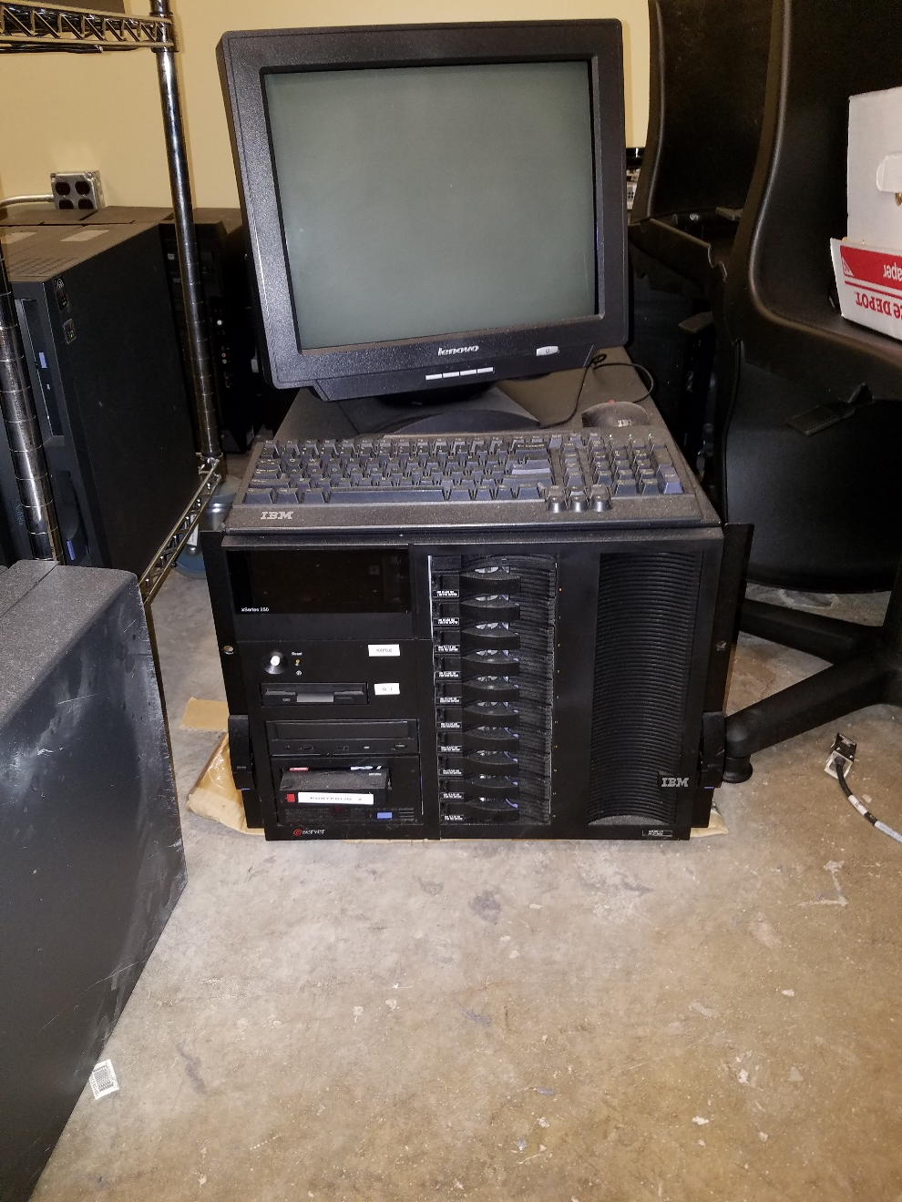

Slide 57
Third Cluster
In 2014 we acquired 70 IBM PC to replace the current Skynet Cluster nodes. But with all used PC we had to get parts to upgrade the RAM to a new level of performance.
Master PC
Processor: Pentium D (Dual Core) @ 3.0 GHz
Memory: 4 GB
Drives: 1-160GB
Networking: 2-10/100Mbps Ethernet adapters
Number of Master = 1
Node PC
Processor: Pentium D (Dual Core) @ 3.0 GHz
Memory: 2 GB
Networking: 10/100Mbps Ethernet adapter
Number of nodes = 64
Spare PC
Processor: Pentium D (Dual Core) @ 3.0 GHz
Memory: 2 GB
Networking: 10/100Mbps Ethernet adapter
Number of units: 4

Slide 58
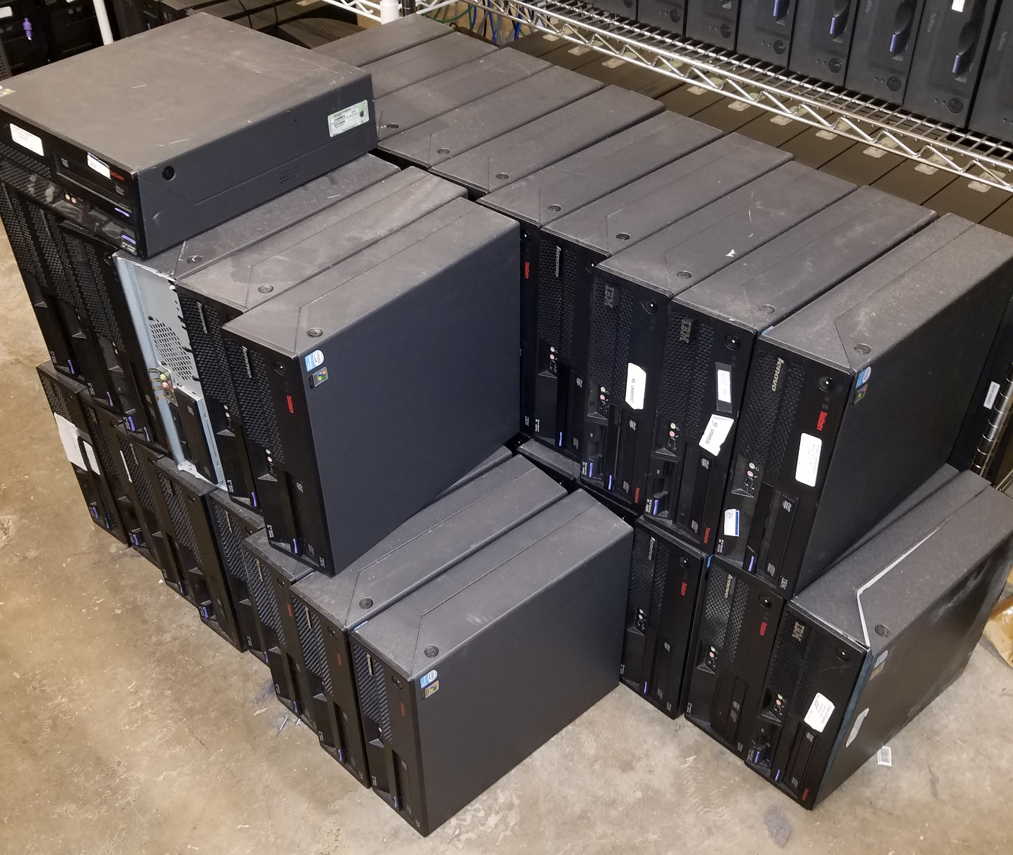

Slide 59
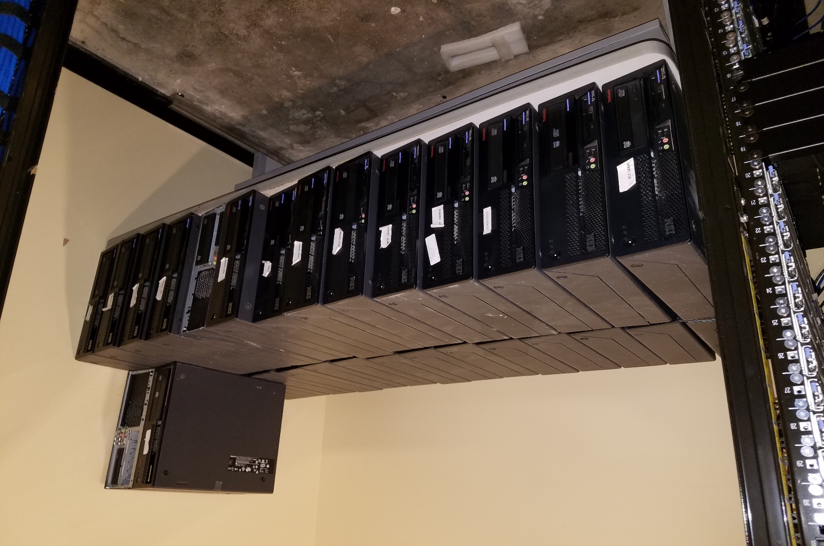

Slide 60
Fourth Cluster
On the way to building our third cluster, the University of Arkansas decommission it Star of Arkansas Cluster. We received 3 Dell cabinets with 64 U1 computers and the 10 Gbps networking components.
We were to house the cluster in the Webb Center building but access and power restriction delayed setup and installation. It has since been move to Science 248 with the rest of our clusters and will be reassembles there.
Node PC
Processor: 2 Xeon E5430(Quad Core) @ 2.66 GHz
Memory: 8 - 2GB 667 DDR2
Networking: 10 Gbps Ethernet adapter
Number of nodes = 64

Slide 61
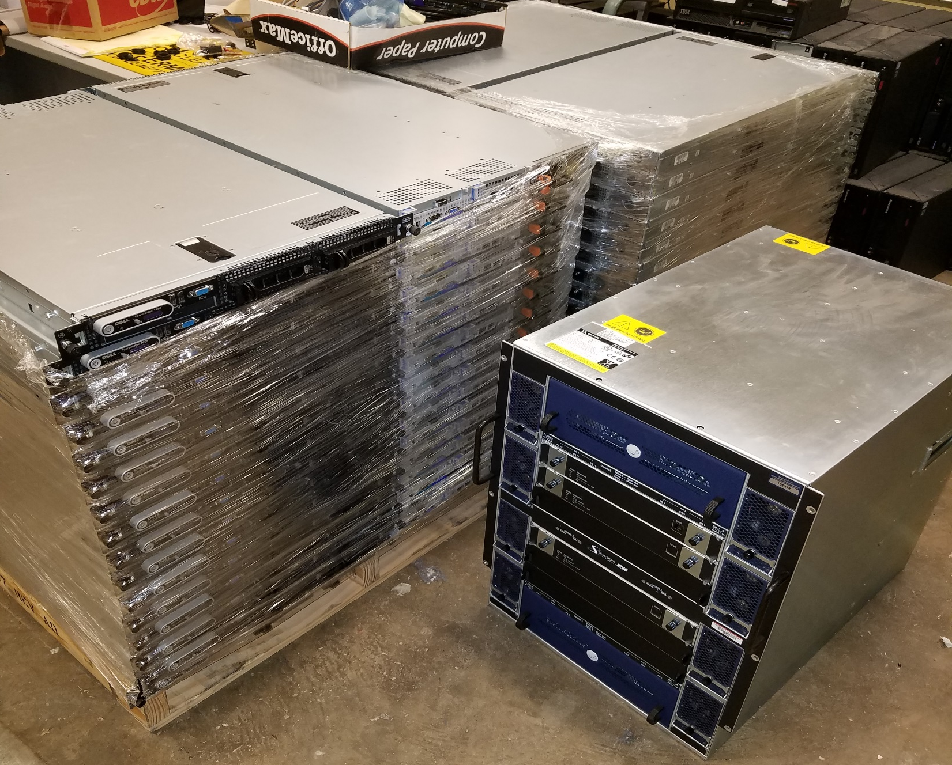

Slide 62
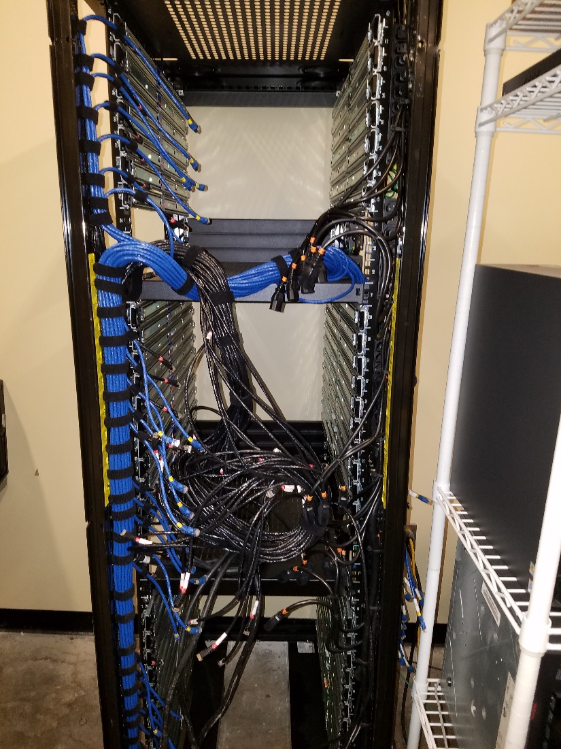
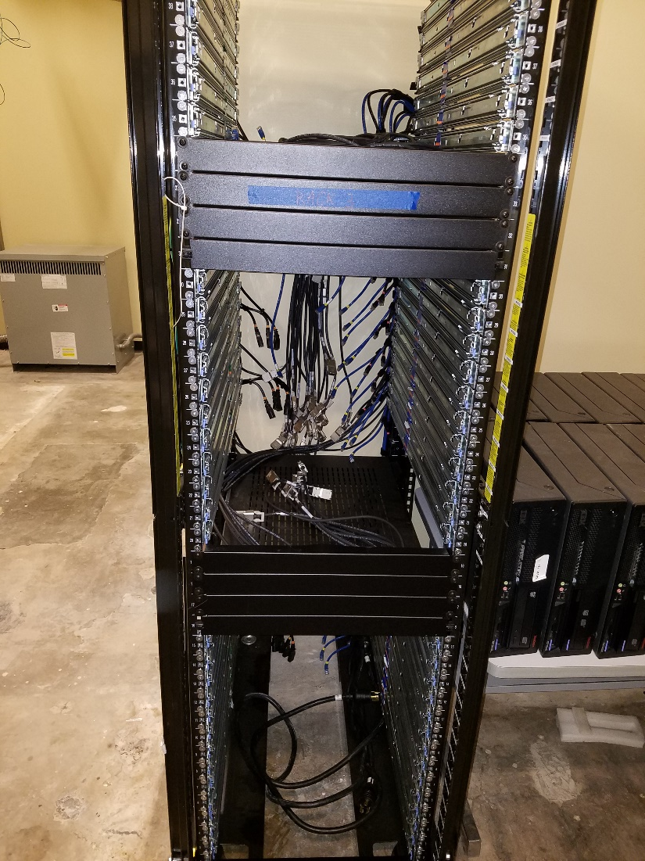

Slide 65
Thanks for your attendance!

